Slide 1
Why are so many children still not in school?
On the first ‘Share a Pencil Day’, we look at how important an education is and why so many children around the world are not able to attend school

Slide 2
In September 2015 193 countries of the United Nations adopted a set of goals called the SUSTAINABLE DEVELOPMENT GOALS (or SDGs) to end poverty, protect the planet, and ensure prosperity for all as part of a new sustainable development agenda. Each goal has specific targets to be achieved by 2030.
For the goals to be reached, everyone needs to do their part: governments, the private sector, civil society and people like you.
Do you want to get involved? You can start by telling everyone about them. We’ve also put together a list of actions that you can take in your everyday life to contribute to a sustainable future.

Slide 3
Numbers in Action, click on the image to see song, opens in new window

Slide 5
Together with , as part of Share a Pencil day, pupils are learning why so many children around the world cannot attend school.
We will focus on the UN Global Goal #4: Ensure inclusive and quality education for all and promote lifelong learning
Learning Objectives:
I can understand the range of reasons why children around the world are unable to attend school.
I can investigate and discuss the case studies of children who have experienced what it is like to be unable to attend school
I can suggest what action might be taken to ensure that all children are able to attend school
Click the image to go the Goal #4 webpage if you want to find out more.

Slide 6
What’s great about school?

Slide 7
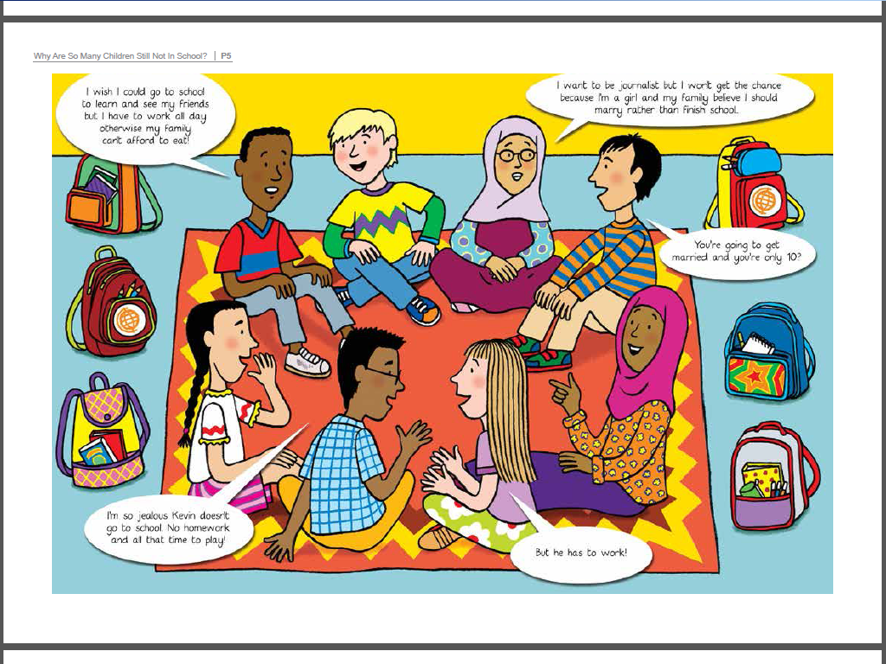

Slide 8
Why are some children not able to attend school?

Slide 9
Task: work in groups to investigate the case study of 4 children. Find out what has happened in their lives which now prevents them from attending school.
Click on the image above to access the 4 case studies, print pages 7 to 10 for use in class

Slide 10
CHALLENGE: After reading the 4 case studies think of how difficult it is to learn and do your work, when you don’t even have the simplest of tools…. YOU WILL COMPLETE THIS TASK IN PAIRS SHARING ONE PENCIL BETWEEN TWO PUPILS. How does this affect how you learn?
 | Child 1 | Child 2 | Child 3 | Child 4
Who?
Where?
What has happened to prevent them attending school?
Why has this happened?
So What? What impact will this have on their lives?
How can the international community change this ?

Slide 11
What was it like to share a pencil? Why do you think you did this task that way – sharing a pencil? What has it allowed you to think about? DISCUSS or RESPOND IN WRITING

Slide 12
Task: Think about what you enjoy and what you think is important about school. What do you want to tell others about the value of education for ALL CHILDREN. Design your poster and we will share it.
Click on the pencil image to download and print off Poster templates

Slide 13
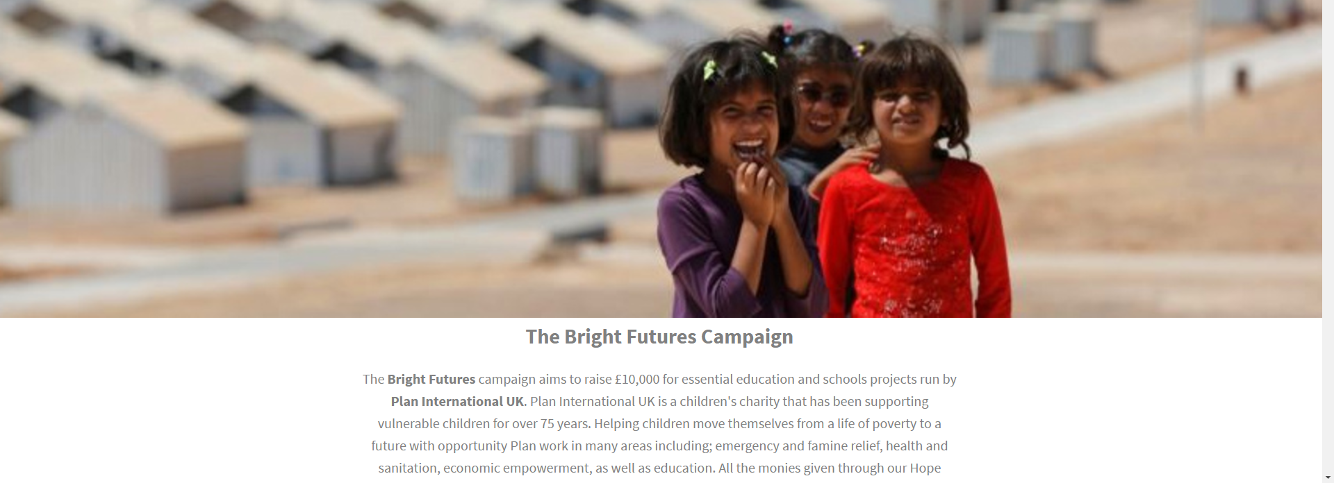
What can you do on Share a Pencil Day to support children around the world?
1. Value your education: make the most of your talents and your strengths. Persevere and have Endurance when learning is challenging. BE THE BEST YOU CAN BE!
2. Visit www.hope.co.uk campaign pages to find out more about what Hope is doing to support global education

